Slide 1
Wav2Letter - Implementing an open source E2E ASR in PyTorch
Assaf Mushkin

Slide 2
Everything you need to know
Wav2Letter is an easy to understand, accurate model for ASR
There are many improvements on it
I’ve made a simple, minimalist PyTorch implementation available online

Slide 3
Agenda
CTC and Wav2Letter
Spinoffs and improvements
Lessons from working with open source projects
Live Demonstration!
Notes:
Revise this slide after finishing the slide
Consider making the demonstration in hebrew

Slide 4
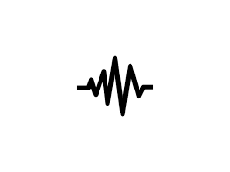
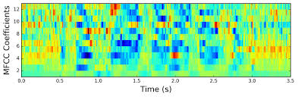

Wav2Letter (2016 - FAIR)
Input spectrograms, Output is CTC (probability of each letter per frame)
A | 0.9 | 0.1 | 0.3 | 0
B | 0.1 | 0.7 | 0.1 | 0.1
C | 0 | 0.2 | 0.6 | 0.9
Wav2Letter
Text

Slide 5
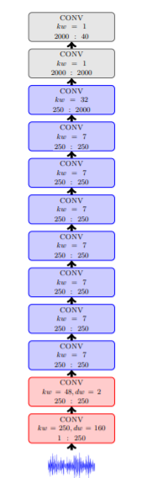
Wav2Letter (2016 - FAIR)
Input spectrograms, Output is CTC (probability of each letter per frame)
Fully convolutional, just a long stack of convolutions
A | 0.9 | 0.1 | 0.3 | 0
B | 0.1 | 0.7 | 0.1 | 0.1
C | 0 | 0.2 | 0.6 | 0.9
Wav2Letter
Text

Slide 6
Wav2Letter (2016 - FAIR)
Input spectrograms, Output is CTC (probability of each letter per frame)
Fully convolutional, just a long stack of convolutions
MFCC features (spectrogram - only slightly worse)
A | 0.9 | 0.1 | 0.3 | 0
B | 0.1 | 0.7 | 0.1 | 0.1
C | 0 | 0.2 | 0.6 | 0.9
Wav2Letter
Text

Slide 7
CTC - “Connectionist Temporal Classification”
For each frame / window, predict probability (or score) of each letter.
Add unique “blank” character, _
When interpreting, drop consecutive identical letters, then drop blanks.
Frame | 1 | 2 | 3 | 4 | 5
A | 0.6 | 0.3 | ... | ... | ...
B | 0.3 | 0.2 | ... | ... | ...
blank | 0.1 | 0.5 | ... | ... | ...
__ABA -> ABA
AA_BA -> ABA
AB_BA -> ABBA
AAA_BB_A__ -> ABA

Slide 8
CTC example
CTC : HH_E_LLLLL_LL_OO HH_O_WWW ARRRR____EE YOUUU
OUTPUT: HELLO HOW ARE YOU

Slide 9
CTC - cont.
CTC can be interpreted “greedily” - pick letter for each frame independently, then run reduction
A | 0.9 | 0.1 | 0.3 | 0
B | 0.1 | 0.7 | 0.1 | 0.1
_ | 0 | 0.2 | 0.6 | 0.9
Notes:
Fix this slide, reorder

Slide 10
CTC - cont.
CTC can be interpreted “greedily” - pick letter for each frame independently, then run reduction
Can also be decoded exhaustive - find output string with highest total score, considering all possible reductions
Notes:
Fix this slide, reorder

Slide 11
CTC - cont.
CTC can be interpreted “greedily” - pick letter for each frame independently, then run reduction
Can also be decoded exhaustive - find output string with highest total score, considering all possible reductions
Greedy results aren’t the best, but are much faster to compute
Notes:
Fix this slide, reorder

Slide 12
CTC - cont.
CTC can be interpreted “greedily” - pick letter for each frame independently, then run reduction
Can also be decoded exhaustive - find output string with highest total score, considering all possible reductions
Greedy results aren’t the best, but are much faster to compute
Practically, we use beam search, weighed with a LM
This adds a bunch more hyperparameters to the process, can be found independently of the acoustic model
Notes:
Fix this slide, reorder

Slide 13
ASG - CTC but with a twist
Used in Wav2letter (2016)

Slide 14
ASG - CTC but with a twist
Used in Wav2letter (2016)
TL;DR: Rarely used in future works, use CTC instead.

Slide 15
ASG - CTC but with a twist
Used in Wav2letter (2016)
TL;DR: Rarely used in future works, use CTC instead.
No usage of blank char, instead repeat last character and use 2 and 3 for repetition (“bo2k” instead of “book”)
This defines a different “reduce” function, and a different simpler decoding algorithm
Global normalization instead of per-frame normalization
This isn’t connected to ASG necessarily, but was in the same paper.

Slide 16
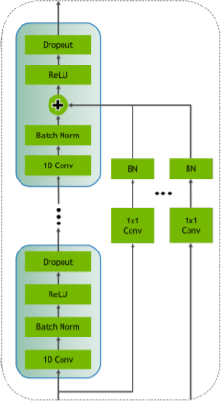

Jasper (2019) - Bigger! Better!
Pretty much Wav2Letter, but with residual connections
“JasperBlock”:
R times: [Conv1d,BN, Relu,Dropout]
+ residual connection
Jasper architecture is B repetitions of JasperBlock

Slide 17
Jasper (2019) - Bigger! Better!
Pretty much Wav2Letter, but with residual connections
“JasperBlock”:
R times: [Conv1d,BN, Relu,Dropout]
+ residual connection
Jasper architecture is B repetitions of JasperBlock
From the paper, B=10 and R=3 (LibriSpeech) or R=5 (WSJ)
3X10 = 30 convolutions, compared to 12 in Wav2letter

Slide 18
Novograd - Jasper’s Optimizer
It’s Adam, but momentum is calculated per layer instead of per weight
Sometimes better end results, but mostly just speedup for ASR task (anecdotally, 30% less epochs to reach same loss)
Current rumour: No speedup in other tasks, compared to Adam
Not implemented in PyTorch yet, but is open-source and available online

Slide 19
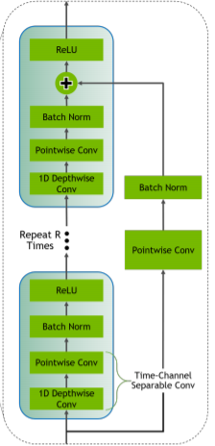
QuartzNet (2019 - 1 month later)
Jasper + 1D Time-Depth-Separable convolutions *
* First use of TDS was in FAIR in a different article

Slide 20
QuartzNet (2019 - 1 month later)
Jasper + 1D Time-Depth-Separable convolutions *
Instead of passing each convolution a matrix of size [window X channels], break into two convolutions.
First convolve over time (treating each channel the same), then convolve over channels with a window of 1. Called depthwise and pointwise convolutions
* First use of TDS was in FAIR in a different article

Slide 21
QuartzNet (2019 - 1 month later)
Jasper + 1D Time-Depth-Separable convolutions *
Instead of passing each convolution a matrix of size [window X channels], break into two convolutions.
First convolve over time (treating each channel the same), then convolve over channels with a window of 1. Called depthwise and pointwise convolutions
Drastically decrease the number of parameters (20 mil. Instead of 100)
* First use of TDS was in FAIR in a different article

Slide 22
Wav2letter improvements
Shorter future context, speedups - better for online decoding (link)
Semi-supervised training (link) - also included ResNet style acoustic models
Lexicon free decoding (link) - better performance on OOV

Slide 23
Sidenote - integrating open source projects
Actually not that hard

Slide 24
Sidenote - integrating open source projects
Actually not that hard
Projects are not libraries, different mindset required

Slide 25
Sidenote - integrating open source projects
Actually not that hard
Projects are not libraries, different mindset required
It will not work out-of-the-box, you will have to read and edit the code

Slide 26
Sidenote - integrating open source projects
Actually not that hard
Projects are not libraries, different mindset required
It will not work out-of-the-box, you will have to read and edit the code
They made mistakes, bad assumptions, or are out-of-date

Slide 27
Sidenote - integrating open source projects
Actually not that hard
Projects are not libraries, different mindset required
It will not work out-of-the-box, you will have to read and edit the code
They made mistakes, bad assumptions, or are out-of-date
The price we pay for cutting-edge developments

Slide 28
Show, don’t tell
Demonstration training for a very small dataset
Tensorboard is useful for visualizing training process
Repository available at https://github.com/assafmu/wav2letter_pytorch
PyTorch implementation, intentionally minimalist
Notes:
Training with CTC usually has 4 phases - gibberish, only blanks, blanks and a single character, and text.
You can measure using 3 metrics - loss, CER, and WER. Loss will start dropping first, followed by CER, and WER will start dropping last.
Merge everything into master (since it seems to work and pass tests, but not achieve min WER), and add simplified_train.py file
Alt-tab to putty (not moba! UTF-8 terminal support) with training configured, set up screen for help and screen for training ahead of time
Open tensorboard link: http://52.170.238.36:6006/, remember to setup tensorboard to a new directory before hand (meetup_visualize or something like that)

